Slide 1

Network Port Scanner GUI
NAME - Samay Dipak Salunkhe
AICTE ID -STU67683c93281951734884499
College Name - JSPM University, Pune

Slide 2

PROBLEM STATEMENT
The Need: Network administrators, developers, and cybersecurity students must regularly check systems for open, potentially vulnerable ports
The Challenge: Existing professional tools are heavily text-based, have a steep learning curve, and lack simple, visual progress tracking.
The Goal: To develop a lightweight, multi-threaded graphical application (GUI) that makes network scanning fast, accessible, and user-friendly.

Slide 3
PROJECT DESCRIPTION
Project Overview The Cyber Port Scanner is a lightweight, high-performance graphical network utility built in Python. Designed as an accessible alternative to complex command-line scanning tools, this application allows users to identify open TCP ports on target IP addresses or hostnames. By utilizing a multi-threaded architecture, the scanner can rapidly check thousands of ports in seconds without freezing the user interface, making it ideal for network administrators, cybersecurity students, and IT professionals conducting preliminary security audits.

Slide 4

WHO ARE THE END USERS?
Cybersecurity & IT Students
Why they use it: Students learning about networking, ethical hacking, or system administration often find complex command-line tools (like Nmap) intimidating at first.
How it helps: Your visual UI, clear progress bars, and color-coded results make it much easier for them to grasp the concept of open/closed ports and network mapping without getting lost in terminal syntax.
Software Developers & Engineers
Why they use it: Developers frequently build applications that communicate over specific network ports (like a web app on port 8080, a database on 5432, or a local server on 3000).
How it helps: They can use your tool to quickly verify if their local server is running, if a port is successfully exposed, or if a firewall is blocking their application's traffic.

Slide 5

Technology Used
Core Language: Python 3 (Logic and execution)
Graphical Interface: Tkinter & TTK (Used to build the custom, dark-themed GUI)
Networking Engine: Python socket Library (Handles the TCP connection requests)
Concurrency Engine: threading & queue Modules (Enables fast, multi-threaded scanning of multiple ports at once)
Data Management: datetime & File I/O (Used for real-time clock tracking and saving exportable text logs)

Slide 6
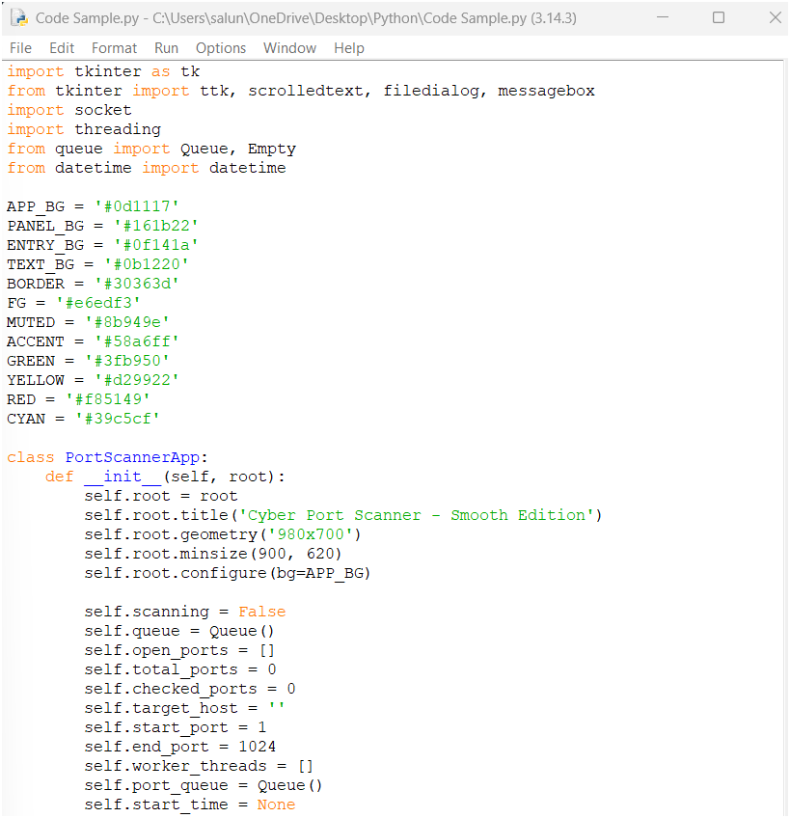
RESULTS
Demo Link

Slide 7
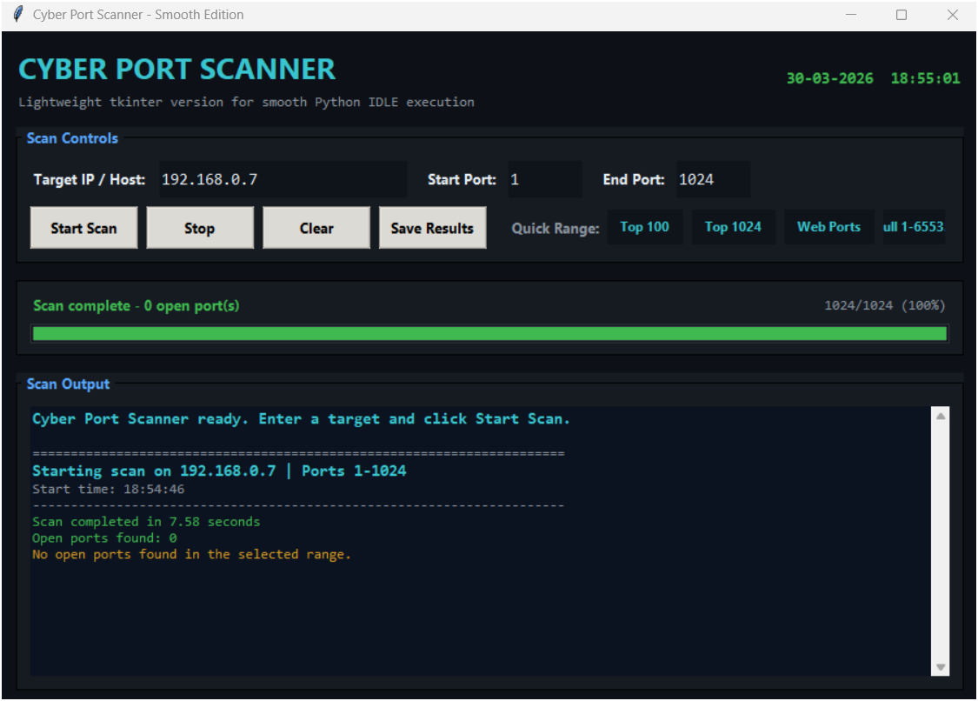
RESULTS
Demo Link

Slide 8
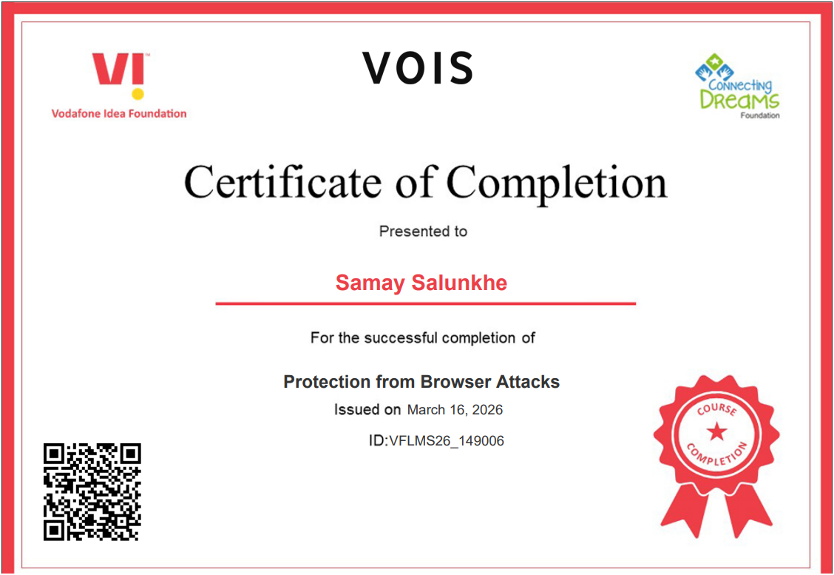
Certificate - Protection from browser attacks

Slide 9
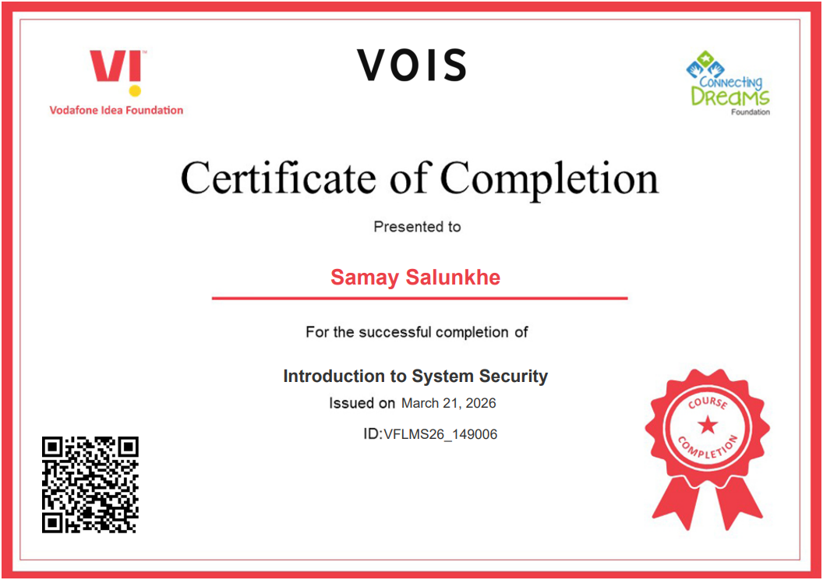
Certificate - Introduction to System Security

Slide 10
GitHub link
https://github.com/evenkeon/Network-Port-Scanner-GUI.git

Slide 11
Thank you
.

